Slide 1
Network Intrusion Detection System using Machine Learning
CAPSTONE PROJECT
Presented By:
Student Name-Shreyas Lingwal
College Name-Doon University
Department-School of Technology

Slide 2
OUTLINE
Problem Statement
Proposed System/Solution
System Development Approach
Algorithm & Deployment
Result
Conclusion
Future Scope
References

Slide 3
Problem Statement
The increasing sophistication of cyber attacks poses a significant threat to the security and integrity of communication networks. Traditional security measures are often insufficient to detect novel and complex intrusion attempts. There is a critical need for an intelligent system that can proactively identify and classify malicious network activities in real time. The challenge is to distinguish between normal network traffic and various types of attacks such as Denial of Service (DoS), Probes, Remote to Local (R2L) and User to Root (U2R) to provide an early and accurate warning system.

Slide 4
Proposed Solution
The proposed system is a robust Network Intrusion Detection System (NIDS) that leverages machine learning to analyze network traffic data and classify connections as either 'normal' or 'anomaly' (attack). The system will provide a critical layer of security for modern communication networks.
The solution comprises the following key components:
Data Collection: The system is built using a foundational network intrusion dataset such as the NSL KDD dataset which contains a wide range of simulated network connections with labeled normal and attack traffic.
Data Preprocessing: Raw network data is processed to be suitable for the machine learning model. This involves:
Encoding Categorical Features: Converting non numeric data like protocol_type and service into a numerical format using one-hot encoding.
Scaling Numerical Features: Normalizing the range of numerical features using standard scaling to ensure the model treats all features equally.
Machine Learning Algorithm: A neural network classifier is implemented using PyTorch. This model is trained to learn the complex patterns that differentiate normal traffic from various cyber-attacks.
Deployment: The trained model is deployed as an interactive web application using Gradio and hosted on Hugging Face Spaces. This allows for easy demonstration and accessibility, enabling users to input network data and receive real-time predictions.
Evaluation: The model's performance is rigorously assessed using standard metrics including accuracy, precision, recall, F1-score
and a confusion matrix to ensure its effectiveness and reliability.
Result: The model's effectiveness will be presented through detailed performance metrics, including a classification report, confusion matrix and visualizations of accuracy and loss curves demonstrating its capability to achieve high accuracy (approx. 98%) in detecting intrusions.

Slide 5
System Approach
The project follows a structured methodology to ensure a robust and reproducible outcome. The approach is divided into distinct phases, from data preparation to
final deployment.
Methodology
Data Preparation and Exploration: The process begins with loading the NSL KDD dataset using Pandas. A critical preprocessing pipeline is then constructed using
Scikit learns ColumnTransformer. This pipeline handles:
One Hot Encoding: For categorical features like protocol_type, service, and flag.Standard
Scaling: For all numerical features to normalize their scale and prevent features with larger ranges from dominating the model.
Model Development and Training: A feed forward neural network is defined using PyTorch's nn.Module class. The preprocessed dataset is split into training and validation sets .The model is then trained iteratively over 20 epochs. In each epoch, the model processes batches of training data, calculates the Cross Entropy Loss and
uses the Adam optimizer to update its weights through backpropagation.
Model Evaluation: After each training epoch, the model's performance is evaluated on the separate validation set. Key metrics including validation loss and accuracy are tracked to monitor learning progress. Once training is complete a final evaluation is performed to generate a detailed classification report and a confusion matrix.
Implementation and Deployment
Implementation: The trained PyTorch model (state_dict()) and the Scikit learn preprocessing pipeline (preprocessor.joblib) are saved to disk. These artifacts are the core components for prediction on new data.
Deployment: The saved model and preprocessor are loaded into a Gradio application script. This script defines a user interface with input fields for all network features. The application is hosted on Hugging Face Spaces providing a live interactive demo that showcases the models predictive capabilities.
System Requirements & Libraries
Hardware: Standard computer with CPU and RAM but GPU recommended for faster training.
Software & Libraries: Python 3.x, PyTorch (model building), Pandas (data handling), Scikit learn (preprocessing), NumPy (numerical operations), Matplotlib/Seaborn (visualization), Joblib (saving preprocessor), Gradio (UI deployment) and Huggingface(deployment)

Slide 6
Algorithm & Deployment
Algorithm Selection: A feed forward neural network (Classifier) built with PyTorch was selected. This architecture is effective at learning non linear relationships in high dimensional data making it well suited for classifying complex network traffic patterns. The model consists of linear layers with ReLU activation functions and a dropout layer to prevent overfitting.
Data Input: The model is trained on a dataset with 41 different features describing each network connection. These features include:
Basic features of TCP connections (e.g., duration, protocol_type, src_bytes).
Content features within a connection (e.g., logged_in, num_failed_logins).
Traffic features computed using a time-window (e.g., count, srv_count).
Training Process: The model is trained using a supervised learning approach. The dataset is split into training and validation sets. The training process involves:
Optimizer: Adam optimizer.
Loss Function: Cross Entropy Loss suitable for binary classification problems.
Epochs: The model is trained for multiple epochs iteratively adjusting its weights to minimize the loss function
Deployment & Prediction Process: The saved model and preprocessor are loaded into a Gradio application. This application provides a simple web interface where a user can input the feature values for a network connection. The application processes this input feeds it to the model and displays the final prediction ('normal' or 'anomaly') in real time. The entire application is hosted on Hugging Face Spaces making it publicly accessible for demonstration.

Slide 7
Result
The model demonstrated high performance on the validation dataset achieving an accuracy of approximately 98%.
Classification Report: The report showed high precision and recall for both 'normal' and 'anomaly' classes indicating the model is effective at correctly identifying both types of traffic with few errors.
Confusion Matrix: The confusion matrix visually confirmed the models high accuracy. The diagonal values (true positives and true negatives) were very high while false positives and false negatives were low showcasing the models reliability.
Loss and Accuracy Curves: Plots of the training and validation loss showed a steady decrease over epochs while accuracy curves showed a steady increase indicating successful learning without significant overfitting.

Slide 8
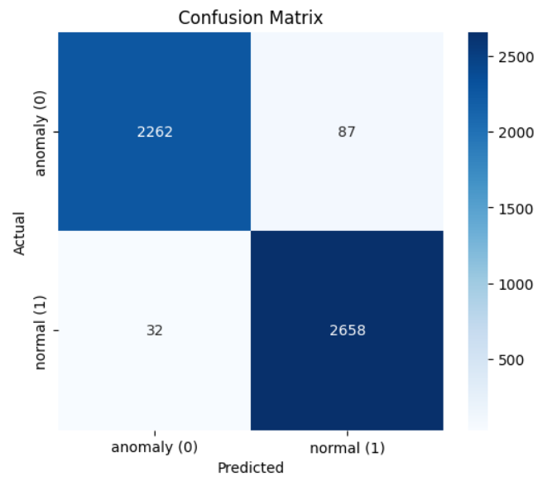
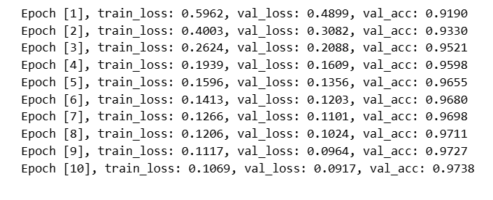
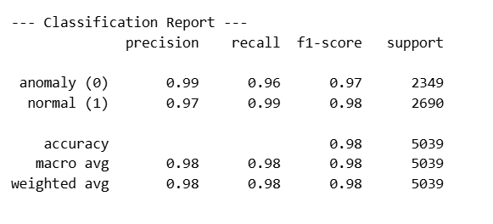
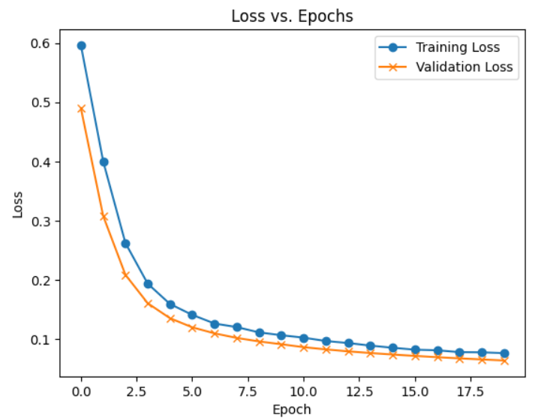
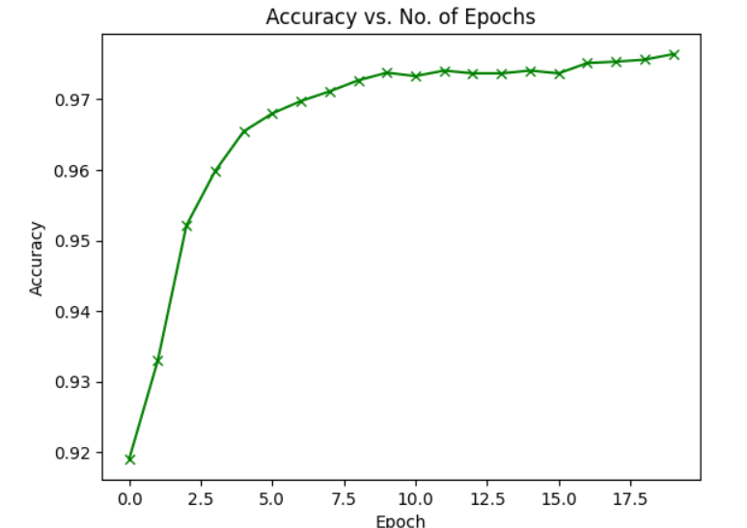
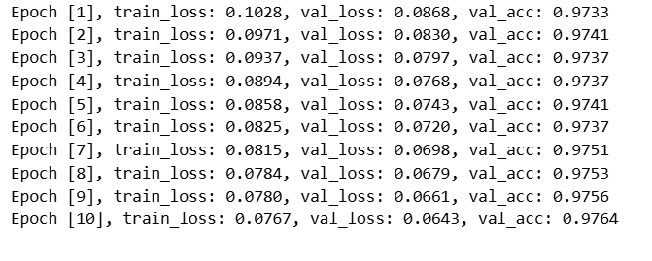
ResultS

Slide 9
Conclusion
In conclusion this project successfully demonstrates the efficacy of a PyTorch based neural network for network intrusion detection. The model achieved an outstanding accuracy of approximately 98% on the validation data a result that is strongly supported by high precision and recall scores for both 'normal' and 'anomaly' classifications. The detailed analysis including the confusion matrix and learning curves confirms that the system is not only accurate but also robust with minimal false positives and negatives and shows no signs of significant overfitting.
This solution serves as a powerful proof of concept for applying deep learning to enhance cybersecurity. The successful deployment of the model as an interactive web application using Gradio and Hugging Face Spaces further validates its practical potential making the technology accessible for demonstration and real world application. The project lays a solid foundation for a new generation of intelligent security systems capable of defending against a wide array of cyber threats.

Slide 10
Future scope
While the current model is highly effective, there are several avenues for future enhancement:
Real Time Implementation: Deploy the model in a live network environment using packet sniffing libraries (like Scapy) to perform real time intrusion detection.
Advanced Models: Explore more complex architectures like Recurrent Neural Networks (RNNs) ,Convolutional Neural Network (CNNs) or Long Short Term Memory (LSTM) networks to better capture the sequential nature of network traffic.
Expanded Attack Classification: Train the model to perform multi class classification to identify the specific type of attack (e.g., DoS, Probe, R2L) instead of just a binary 'anomaly' classification.
Continual Learning: Implement a mechanism for the model to be periodically retrained on new data to adapt to emerging, previously unseen attack patterns.

Slide 11
References
Tavallaee, M., Bagheri, E., Lu, W., & Ghorbani, A. A. (2009). A detailed analysis of the KDD CUP 99 data set. 2009 IEEE Symposium on Computational Intelligence for Security and Defense Applications.
Paszke, A., et al. (2019). PyTorch: An Imperative Style, High Performance Deep Learning Library. Advances in Neural Information Processing Systems 32.
Abid, A., Abdalla, A., et al. (2021). Gradio: Hassle Free Sharing and Testing of ML Models in the Wild. ICML 2021 Workshop on Human in the Loop Learning.
Hugging Face. (2024). Hugging Face Spaces Documentation. https://huggingface.co/docs/hub/spaces-overview
PyTorch Documentation. (2024). torch.nn Module. https://pytorch.org/docs/stable/nn.html
Scikit-learn Documentation. (2024). sklearn.compose.ColumnTransformer. https://scikit-learn.org/stable/modules/generated/sklearn.compose.ColumnTransformer.html
Scikit-learn Documentation. (2024). sklearn.preprocessing.StandardScaler. https://scikit-learn.org/stable/modules/generated/sklearn.preprocessing.StandardScaler.html
https://arxiv.org/pdf/2007.02500
https://ietresearch.onlinelibrary.wiley.com/doi/full/10.1049/cit2.12078
https://www.geeksforgeeks.org/machine-learning/intrusion-detection-system-using-machine-learning-algorithms/
https://arxiv.org/html/2503.13195v1
GITHUB LINK:https://github.com/shreyaslingwal/Edunet_internship_project

Slide 12

IBM Certifications

Slide 13

IBM Certifications

Slide 14

IBM Certifications

Slide 15
THANK YOU

